Slide 1
Data Science
A collaboration between SHPE and DSI

Slide 2



DSI
SHPE
How to get involved!

Slide 3
Table of contents
Overview
Activity 1
Activity 2
Activity 3
Wrap Up
Setting up your environment for the workshop
Creating a Correlation Matrix for analyzing insights
Plotting and Visualizing Correlation Matrix
Predictive Modeling with Linear Regression
Open Space for Questions and Workshop feedback.

Slide 4
Overview
Setting up your Environment Follow the next steps to get started!

Slide 5
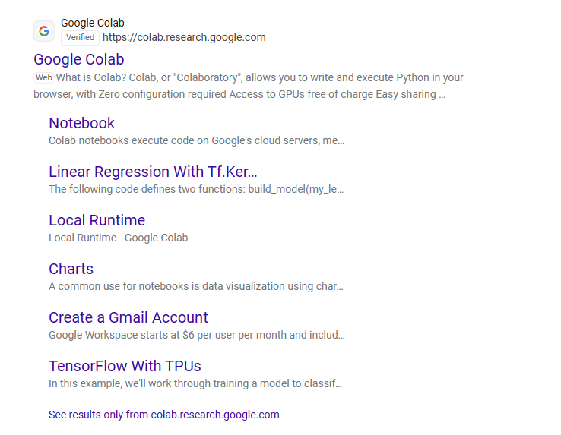
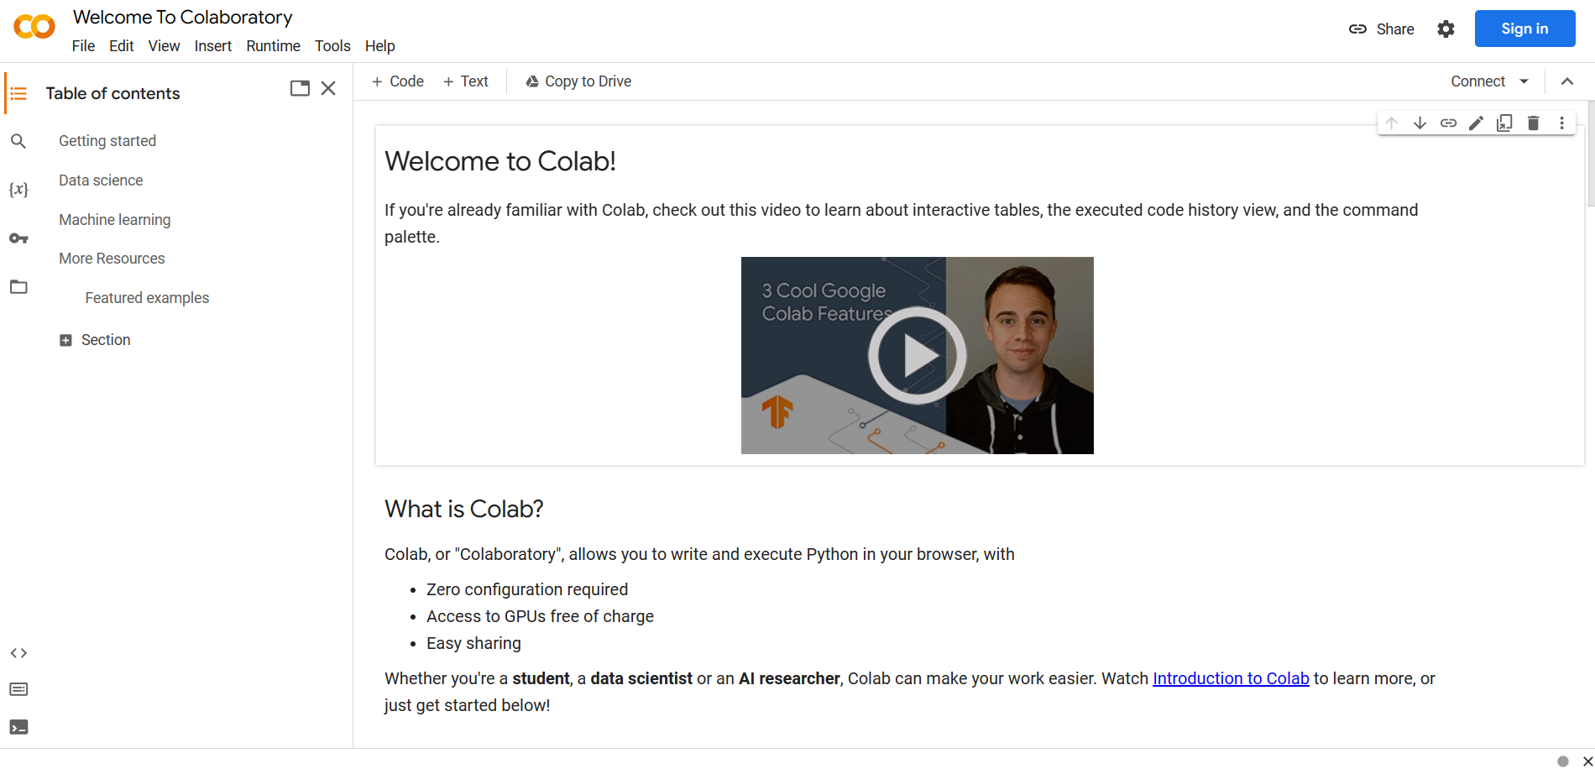
Step by Step
Search “Google Collab” and click on first link
Your screen should look like this

Slide 6
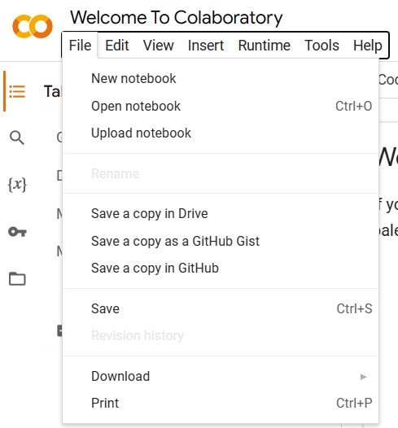
Next click on File, on the upper left of the screen
Then click on Open notebook

Slide 7
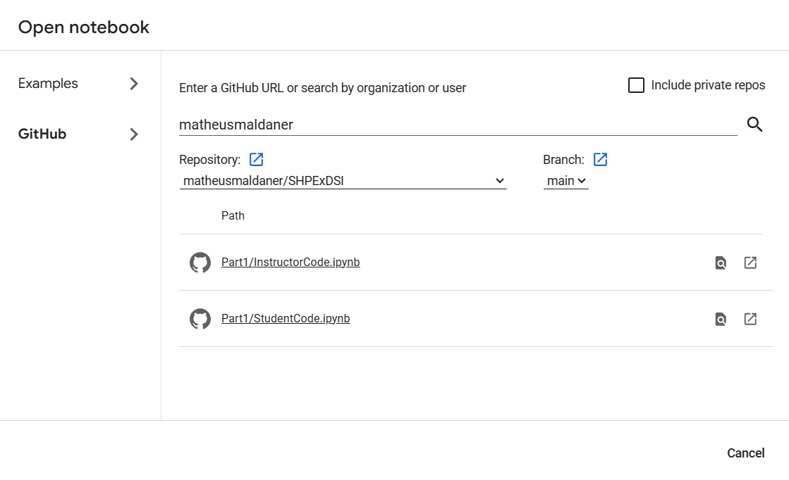
Now click on GitHub, and write matheusmaldaner

Slide 8

Finally, ensure you are under SHPExDSI and click on StudentCode

Slide 9

Workshop Material

Slide 10

Why Python?
About the softwares
Python is Versatile
- Used in web development, data science, artificial intelligence, and more.
Python is Beginner-Friendly
- Readable syntax that resembles English.
Python in Data Science
- The go-to language for data analysis, machine learning, and scientific computing.
Python is Open Source
- Free to use and distribute, even for commercial purposes.
You can replace the image on the screen with your own work. Just delete this one, add yours and send it to the back
You can replace the image on the screen with your own work. Just delete this one, add yours and send it to the back

Slide 11

About Pandas
Essential for Data Handling
- Optimized for performance in data manipulation and analysis, especially with tabular data.
Simplifies Data Analysis
- Offers intuitive data structures and functions for complex tasks like merging, pivoting, and slicing.
Pandas in Data Science
- Critical tool for data preprocessing, cleaning, and analysis in Python-based data science workflows.
Easy Data Exploration
- Includes tools for summary statistics and can be used with other libraries for data visualization.

Slide 12

Other Libraries
Image
Matplotlib
- Plotting library for creating static, interactive, and animated visualizations in Python.
Seaborn
- Based on Matplotlib, seaborn offers a higher-level interface for creating pretty statistical graphics.
Numpy
- Package for scientific computing in Python, with a collection of mathematical functions.
Tensorflow/Pytorch
- Machine learning libraries used for numerical computation and building neural networks
Package = Library

Slide 13
Activity #1
Creating a Correlation Matrix. Identifying trends with numeric data.

Slide 14
Merging Data with Pandas
Merging Dataframes:
Use merge() method in Pandas.
left_on, right_on, and how parameters.
Parameters:
left_on and right_on specify the columns in left and right dataframes to join on.
how parameter determines the type of join (left, right, inner).
Syntax:
DataFrame.merge(right_df, how='inner', on=None, left_on=None, right_on=None, sort=False).
Allows for complex merges, including specifying different join keys for each dataframe.
Join Types:
how = ‘left’ keeps entries from the left dataframe. Non matching records return NaN.
how = ‘right’ keeps entries from the right dataframe. Non matching records return NaN.
how = 'inner' ensures only matching records from both data frames are included in the result.

Slide 15
Creating Correlation Matrix
Correlation Matrix:
Measures the degree of linear relationship between numerical variables.
Identifies which variables move together.
Syntax:
Utilize DataFrame[['release_year', 'runtime', 'total_gross']].corr() for the matrix.
Provides a comprehensive view of correlations in a single table.
Interpreting Values:
Values near +1 or -1 indicate strong positive or negative relationships.
Values around 0 imply no significant linear relationship.
Helpful in identifying potential variables for predictive modeling.

Slide 16
Activity #2
Data Visualization Techniques Plotting your Correlation Matrix with matplotlib

Slide 17
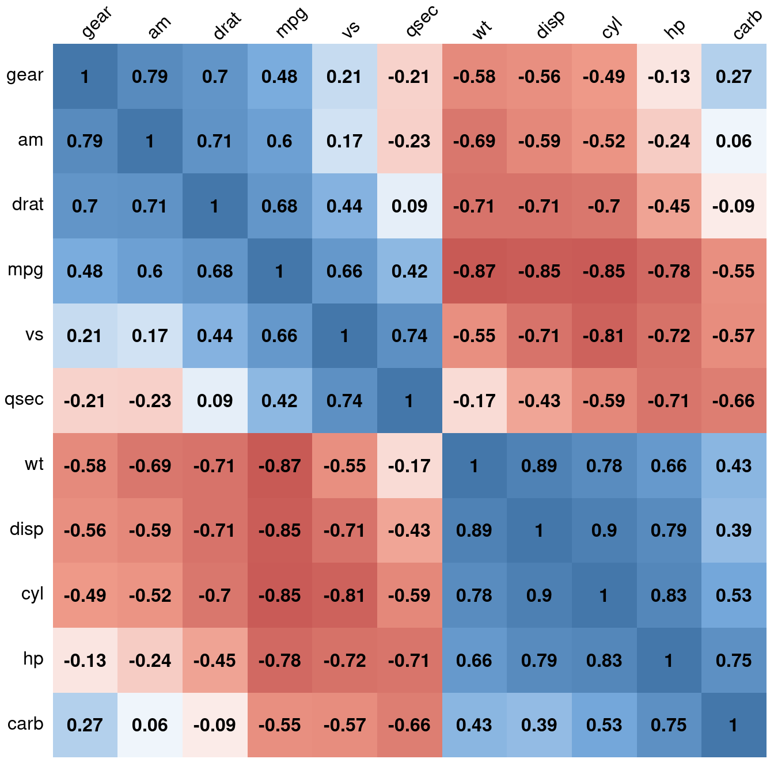
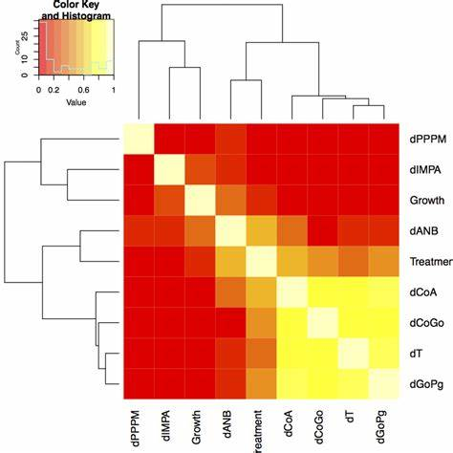
Visualizing your Correlation Matrix
Data Visualization:
Seaborn and Matplotlib can take matrices as parameters
Visualizations help seeing complex statistical information.
Creating a Heatmap:
Code snippet for a heatmap of correlation_matrix1 using sns.heatmap().
Parameters like annot show actual values; cmap controls color scheme.
Advantages of Heatmaps:
Offers a quick, intuitive display of the correlation matrix.
Easier to discern patterns than from numerical data alone.
Correlation matrix
Correlation Matrix Heatmap

Slide 18
Interpreting the Heatmap
Displaying the Heatmap:
Illustrate the generated heatmap for visual analysis.
Color variations in the coolwarm scheme for different correlation strengths.
Analyzing the Heatmap:
Patterns and trends visible in the heatmap.
How to read and understand correlation values.
Insights from Heatmap:
Identify variables with strong or weak correlations.
Visual cues help in decision-making regarding variable importance.
Notes:
Interpreting Visuals: Emphasize how to interpret bar charts and the importance of visual patterns in data analysis.

Slide 19
Activity #3
Predictive Modeling with Linear Regression Using Python to Make Inferences about Data

Slide 20
Introduction to Linear Regression
Linear Regression:
Used for modeling relationships between a dependent variable and 1+ independent variables.
Used to predict outcomes, eg. forecasting sales or determining risk factors in health studies.
Preparing for Regression:
Identify relevant independent variables that could impact the dependent variable.
Ensure data is clean and appropriately formatted for the regression analysis.
Select a variable that potentially influences the outcome.
The Role of Linear Regression:
Helps quantify the strength and direction of relationships between variables.
Proper selection of independent variables is crucial for the model to accurately predict the dependent variable.
Notes:
Types of Joins:
left: use only keys from left frame, similar to a SQL left outer join; preserve key order.
right: use only keys from right frame, similar to a SQL right outer join; preserve key order.
outer: use union of keys from both frames, similar to a SQL full outer join; sort keys lexicographically.
inner: use intersection of keys from both frames, similar to a SQL inner join; preserve the order of the left keys.

Slide 21
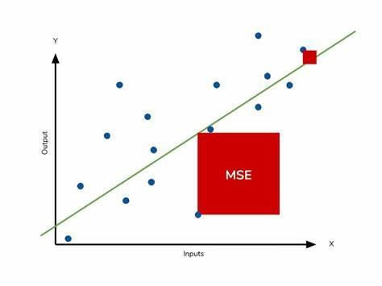
Prediction Metrics
Mean Squared Error (MSE)
Measures the average squared difference between the model's predictions and actual outcomes.
Lower values indicate better model performance.
Penalizes outliers more (see image)
Interpreting Results:
MSE value helps in understanding the extent of error in the model’s predictions.
Lower MSE means the model's predictions are close to actual values.
Additional Topics:
Overfitting and Underfitting
Bias/Variance Trade-Off
Curse of Dimensionality
Comparing MSE of 2 points

Slide 22
Model Implementation
Parameters
Feature Selection: pick variables that likely influence the outcome.
Handling Missing Data: Addressing gaps in data (dropping, inputting)
Data Splitting: Dividing data into training and testing sets.
Training the Model:
Model is trained using the training data, learning the relationship between variables
It self adjusts its parameters to minimize the difference between its predictions and actual outcomes in the training set.
After learning from the training set, model performance is evaluated on test set
Visualizing Regression:
Fitted regression line over the data points shows the model’s predictions.
The visual representation show how well the model fits the data

Slide 23
Questions?

